Slide 1
ML Ranking - Pointwise
Manuel Scurti & Mingjie Ye

Slide 2
Introduction
ML Ranking or Learning to rank is an alternative way to design a ranking function when dealing with a lot of features to describe documents
Main idea: Learn the model from a set of features.
Focus on developing interesting features and less on how to put them together
Why wasn’t learning approaches used earlier?
Limited training data
ML techniques were not good enough
Traditional IR systems used a limited number of features, and thus easy to link together with a formula

Slide 3
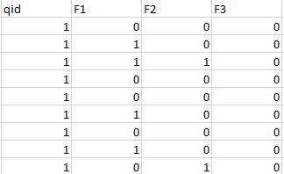
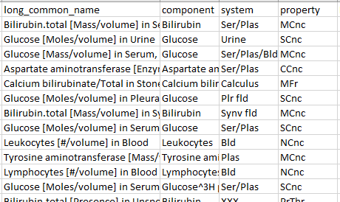
Introduction - Learning to Rank pipeline
EXTRACT FEATURES FROM
DOCUMENT COLLECTION AND
QUERIES
CREATE MODEL AND TRAIN THAT WITH TRAIN DATASET
EXECUTE MODEL ON TEST DATA FOR PERFORMANCE EVALUATION

Slide 4
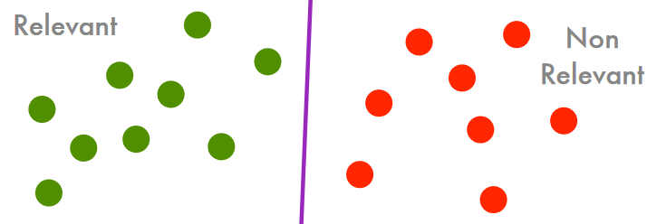
Pointwise approach
Given a set of training examples we train a model to rank documents using:
INPUT SPACE: (query, document) pairs
OUTPUT SPACE: label (relevant / not relevant)
The objective is to find a model able to separate documents, according to a given query, between relevant and non-relevant, minimizing the loss
In the case of the pointwise approach:
INPUT SPACE: single document - relevant/not-relevant to a query
OUTPUT SPACE: scores or relevant classes

Slide 5
Pointwise approach - Limitations
Position of the documents in the ranked list is not modelled by the loss function
Dataset must be balanced enough, to avoid models that emphasize more irrelevant documents than relevant ones

Slide 6
Logistic inference model - Gey’s paper
Logistic regression
Six features: QAF, QRF, DRF, DAF, IDF, RFAD
Output: probability of relevance for documents with respect to a query
Ranking according to the probability of relevance
Compare with Vector Space Model with T-test
Use the model in Cranfield, CACM and CISI dataset to evaluate the performances

Slide 7
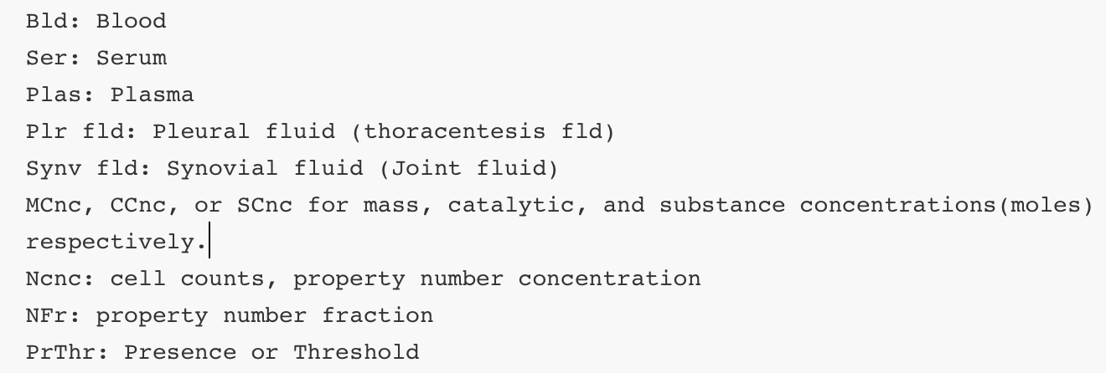
Building the training set
The original dataset defined with three features: component, system and property.
Abbreviations:

Slide 8
Building the training set
Given the original dataset defined with three features: component, system and property,
binary relevance with the query : 1: relevant / 0: irrelevant
Labels named r are defined manually from 0 to 3, the larger, the more relevant.

Slide 9
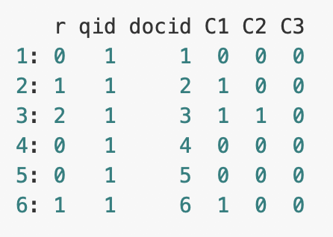
Building the training set
Saved as LETOR format:
Each row corresponds to a query-document pair.
The first column "r" is relevance label of the pair.
The second column is query id.
The third column is document id.
The following columns are features.

Slide 10
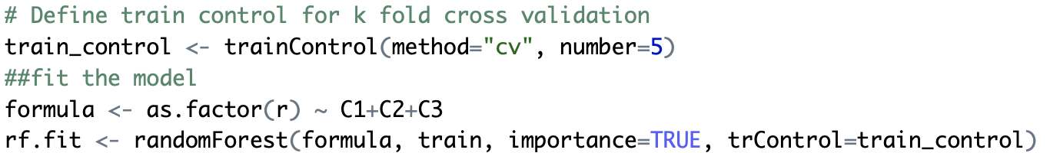
Implementation
Convert to classification problem: Random Forest
5 fold cross validation
80% for training and 20% for testing

Slide 11
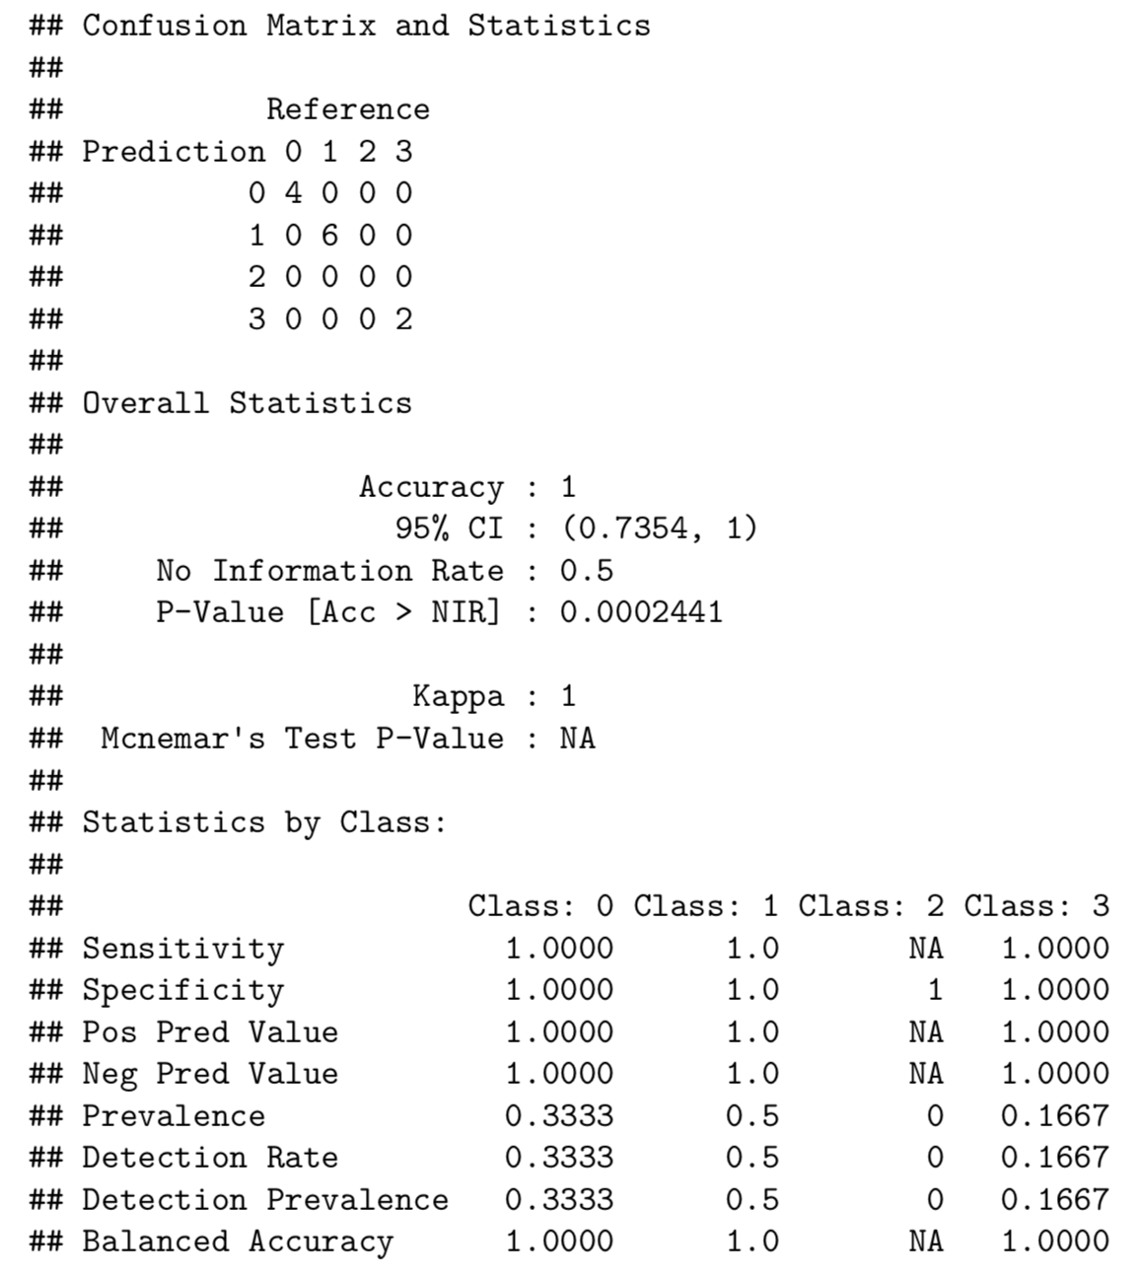

Slide 12
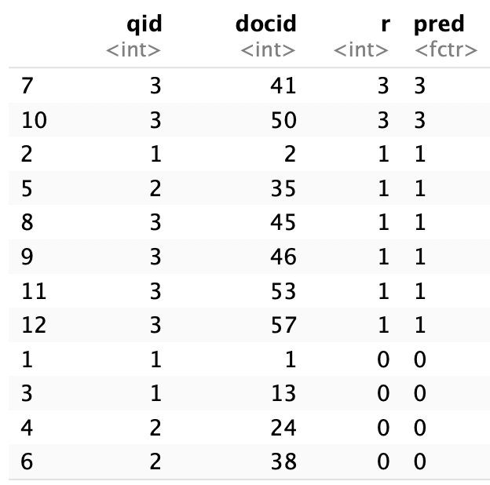
Implementation
Convert to classification problem: Random Forest
5 fold cross validation
80% for training and 20% for testing
Rank according to prediction classification

Slide 13
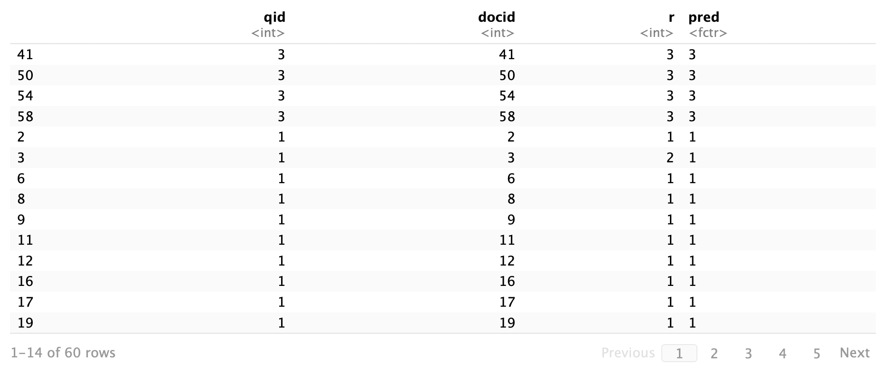
Implementation
Ranking for the whole dataset:

Slide 14
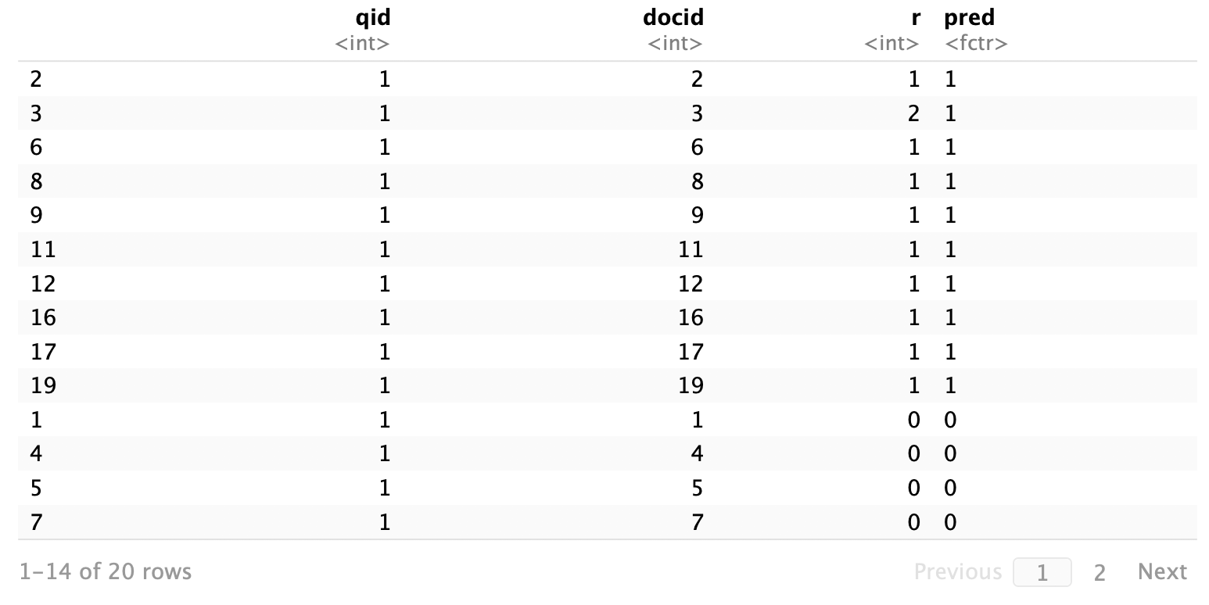
Implementation
Ranking for the one query such as query 1:

Slide 15

Thank you!

